Slide 1
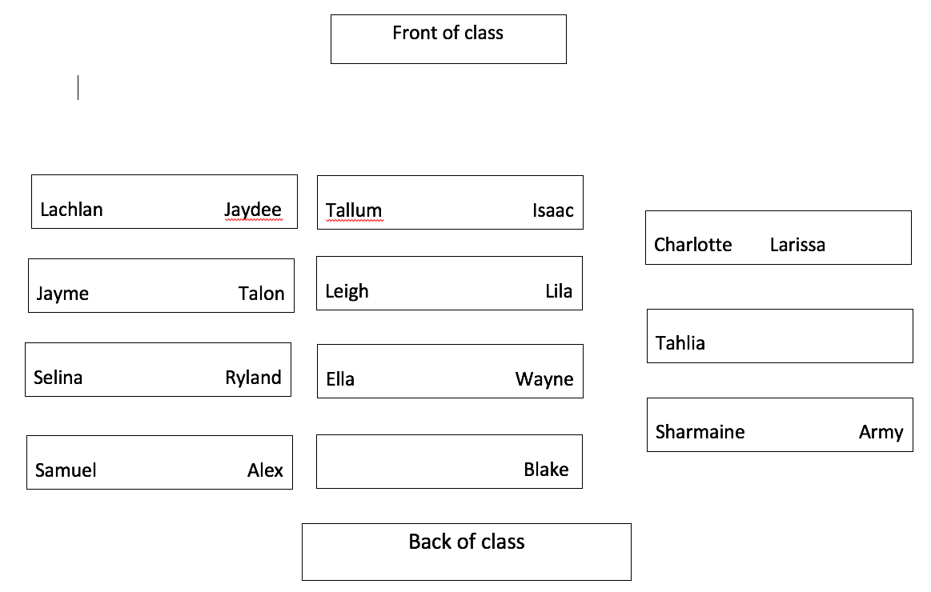

Slide 2
Starter
List all the properties of rocks you can remember.
Define each one.
For example:
1. Hardness- How difficult the object is to scratch
12/ 2 /2020

Slide 3
Starter
List all the properties of rocks you can remember.
Hardness
Density
Lustre
Streak
Cleavage
Magnetism
Colour
12/ 2 /2020

Slide 4
Define Moh’s Scale of Hardness
TRACK WITH ME
READ WITH ME
^{Define Moh’s Scale}
Use an experiment to verify the scale

Slide 5

Moh’s Scale of Hardness
A scale used to measure the relative hardness of a mineral

Slide 6
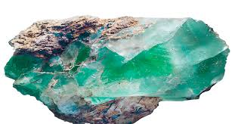

Define Moh’s Scale of Hardness
How would you measure a mineral’s relative hardness?

Slide 7
Moh’s Scale of Hardness
A scale used to measure the relative hardness of a mineral by its resistance to scratching.

Slide 8
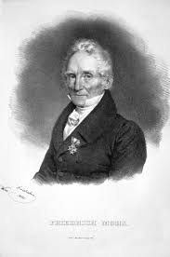
Define Moh’s Scale of Hardness
In 1812 the Mohs scale of mineral hardness was devised by the German mineralogist Frederich Mohs, who selected the ten minerals because they were common or readily available.

Slide 9
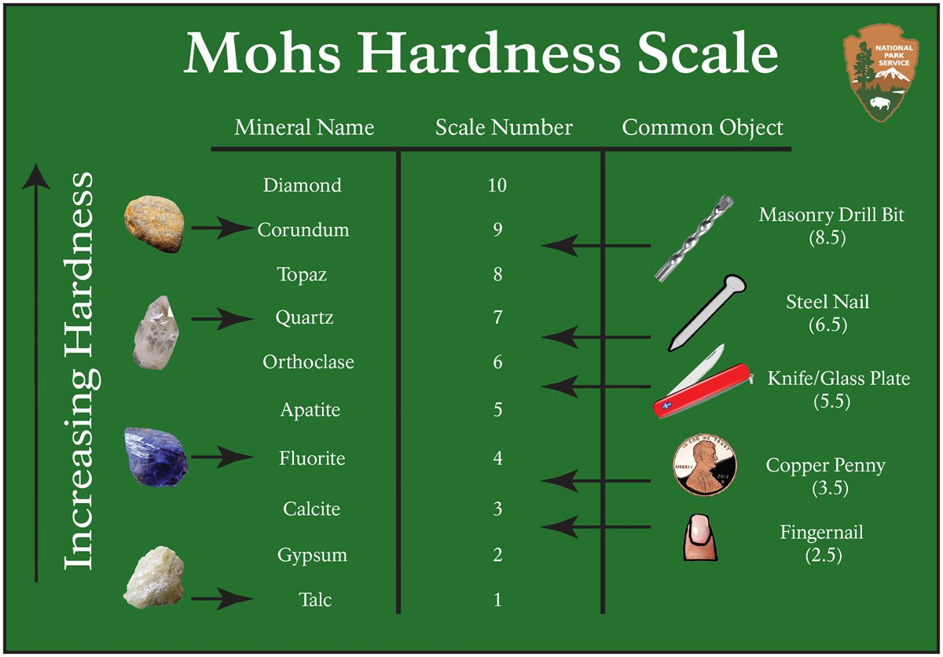

Slide 10
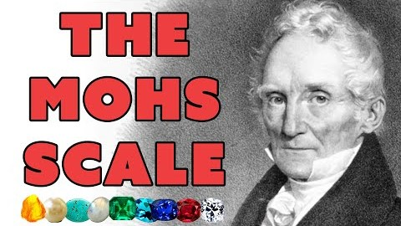
https://www.youtube.com/watch?v=hiNpZqhcQEI

Slide 11
Define Moh’s Scale of Hardness
We are going to do the Moh’s Scale of Hardness Test:

Slide 12
SWBAT describe Moh’s hardness scale in relation to rock samples
Determining Moh’s hardness
Scratch substance with the lowest number one at a time.
If it does not scratch then move to the next hardest object

Slide 13
SWBAT describe Moh’s hardness scale in relation to rock samples
Activity
We are going to rank minerals in order of hardness from based on the Moh’s hardness scale

Slide 14
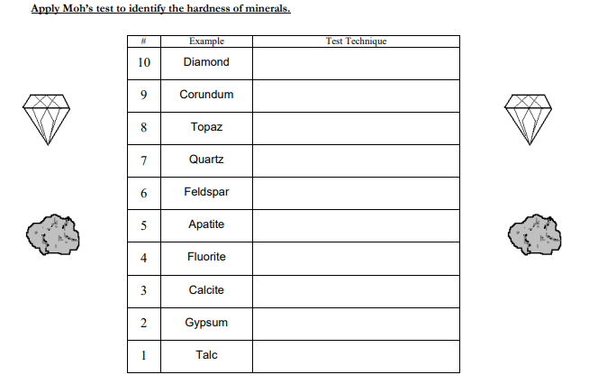
Define Moh’s Scale of Hardness

Slide 15
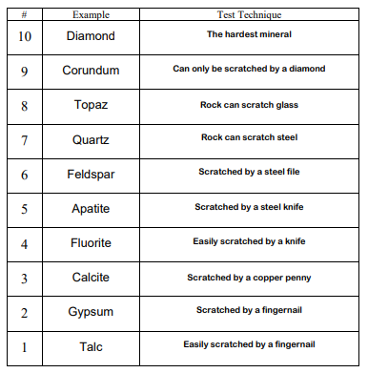
Define Moh’s Scale of Hardness

Slide 16
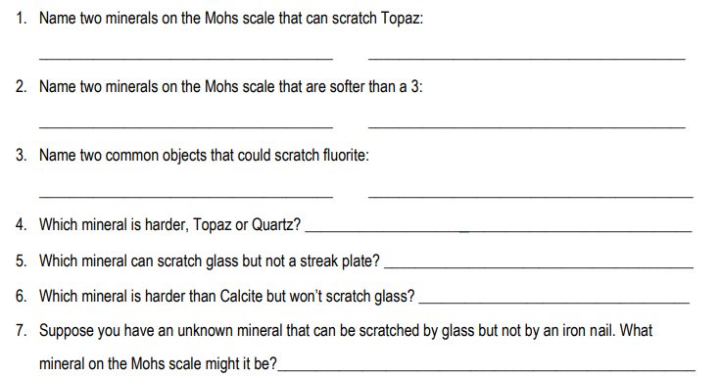
Define Moh’s Scale of Hardness

